Slide 1

CAP-787 DATA SCIENCE TOOLBOX (CA-1)
SUBMITTED BY:
YASH AGARWAL
MCA-DE566
RDE566A03
12000323
SUBMITTED TO:
Dr. APASH ROY (23550)

Slide 2

DOWNLOAD
R 4.1.1

Slide 3
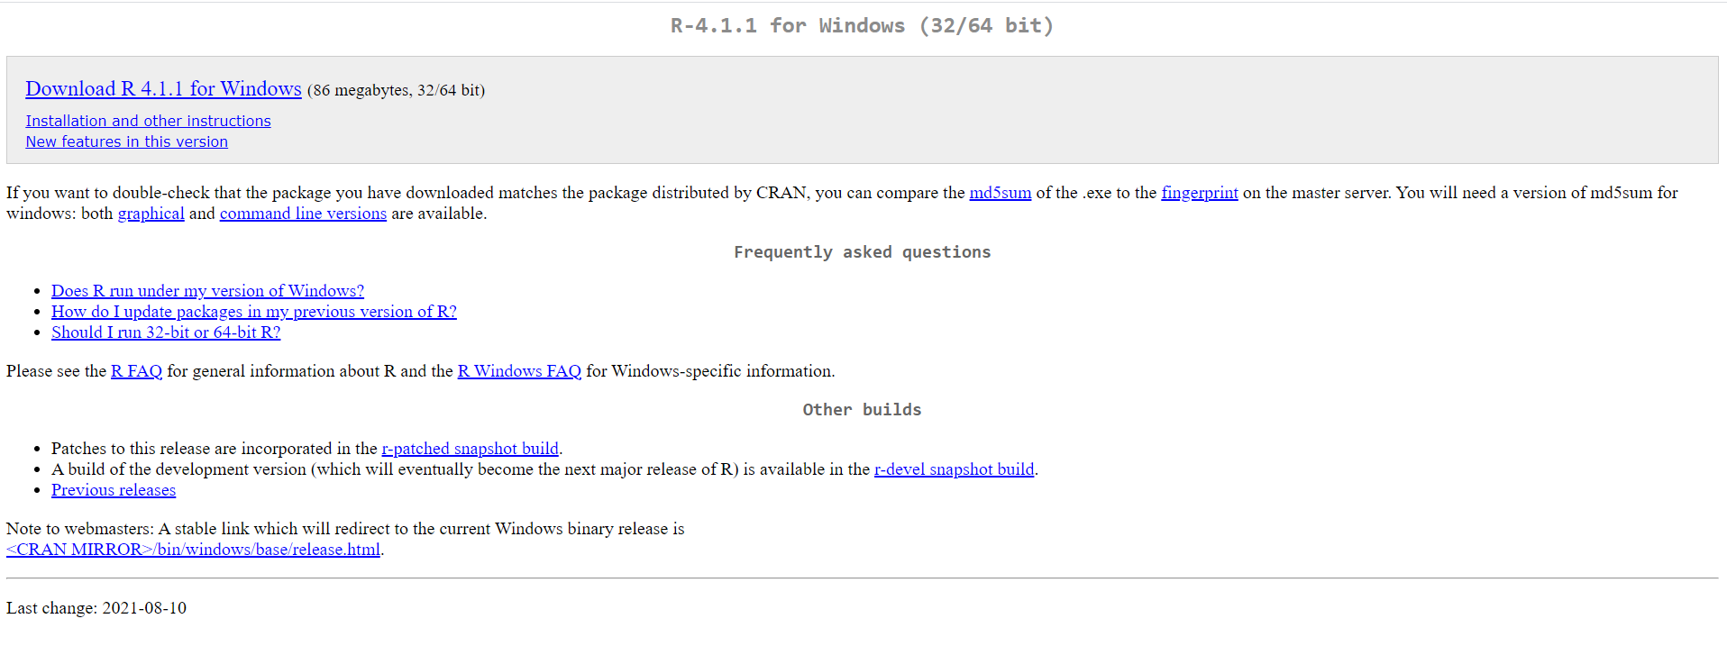
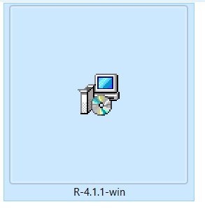
CLICK ON THIS LINK TO DOWNLOAD R 4.1.1
https://cran.r-project.org/bin/windows/base/

Slide 4
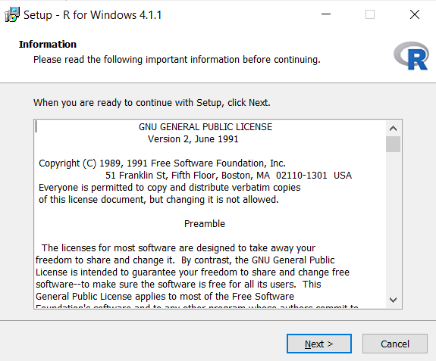
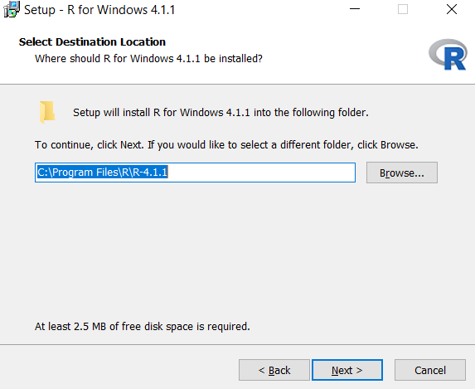
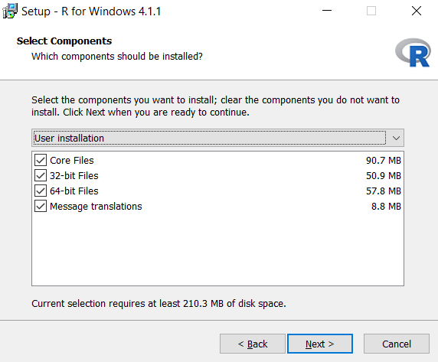
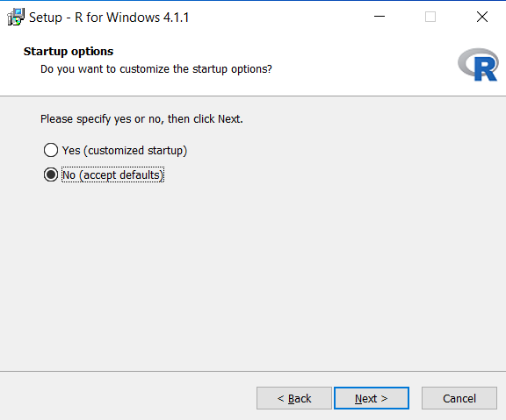
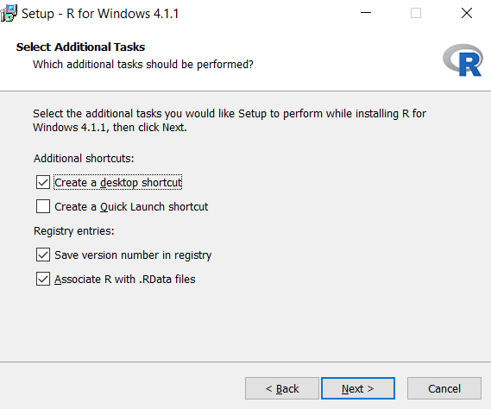
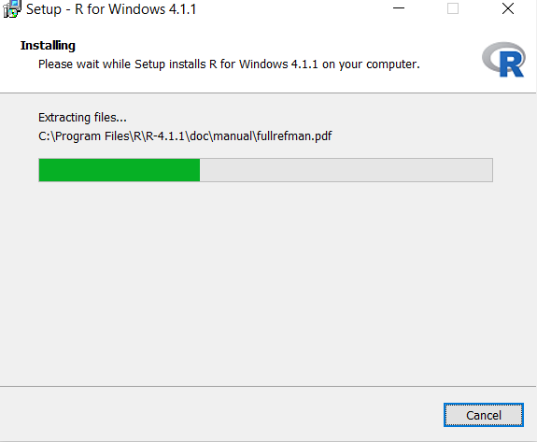
STEPS TO DOWNLOAD R 4.1.1

Slide 5

DOWNLOAD
R STUDIO 4.1.1717

Slide 6
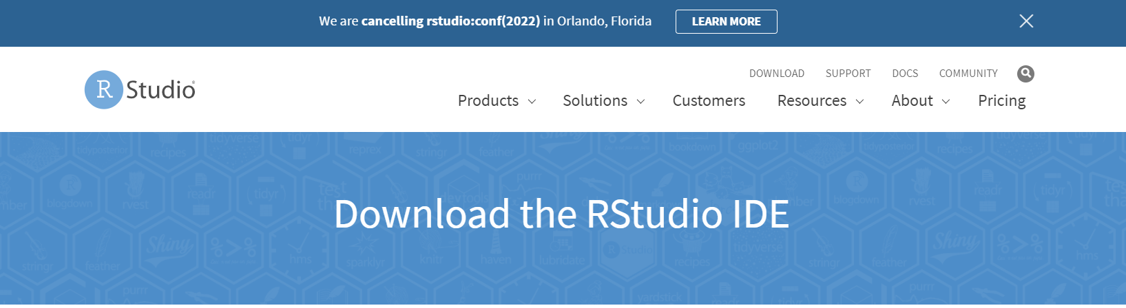
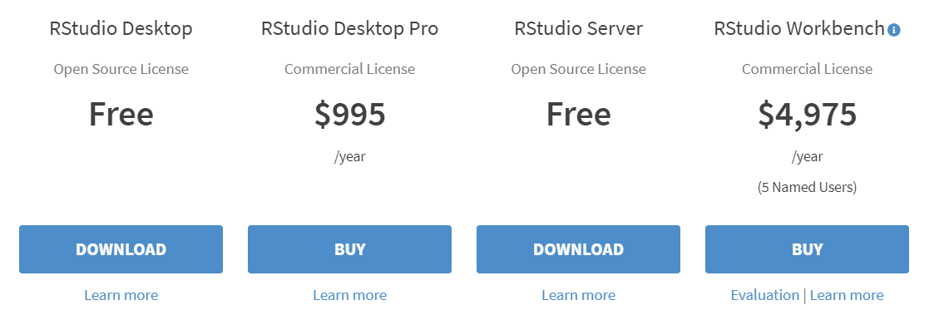
https://www.rstudio.com/products/rstudio/download/
CLICK ON THIS LINK TO DOWNLOAD R Studio 4.1.1717

Slide 7
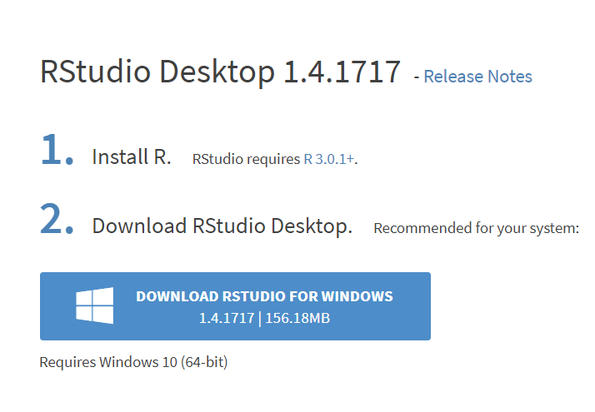
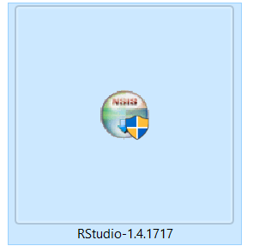
CLICK ON THIS LINK TO DOWNLOAD
R Studio 4.1.1717

Slide 8
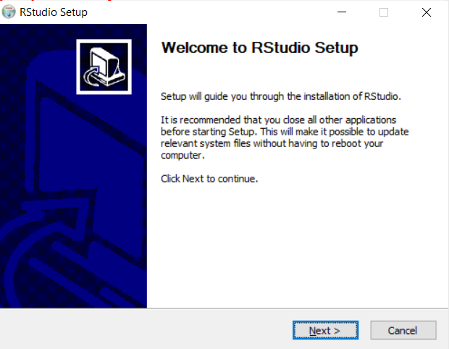
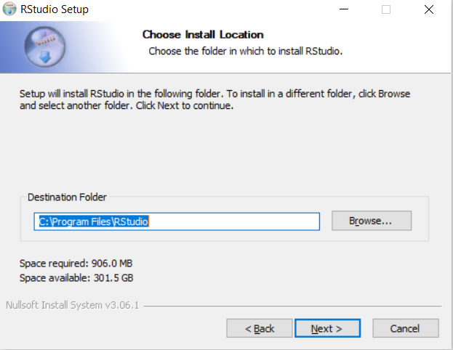
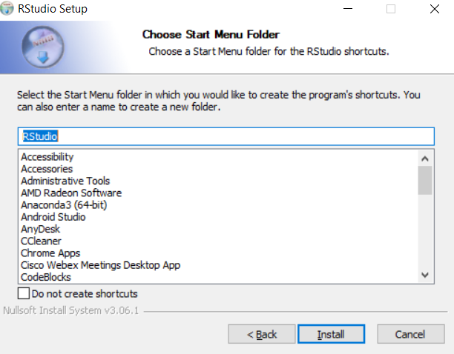
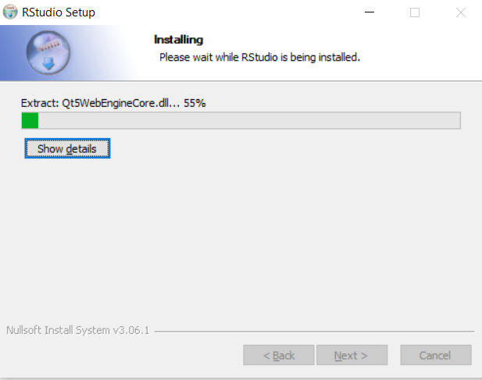
STEPS TO DOWNLOAD R STUDIO 4.1.1717

Slide 9
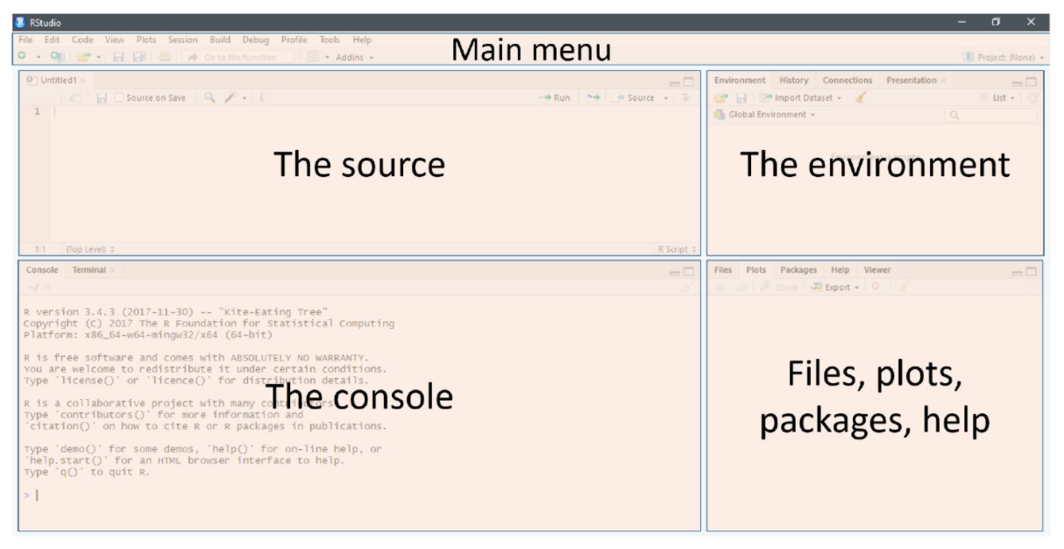
R STUDIO 4.1.1717

Slide 10


